Slide 1
Planning Sales Dialogues and Presentations
6

Slide 2
Learning Objectives
L
1
Explain why it is essential to focus on the customer when planning a sales call.
Understand alternative ways of communicating with prospects and customers through canned sales presentations, written sales proposals, and organized sales dialogues or presentations.
Discuss the nine components in the sales dialogue template that can be used for planning an organized sales dialogue or presentation.
L
2
L
3

Slide 3
Learning Objectives
L
4
Explain how to write a customer value proposition statement.
Link buying motives to benefits of the seller’s offering, support claims made for benefits, and reinforce verbal claims made.
Engage the customer by setting appointments.
L
5
L
6

Slide 4

Sales Dialogue
Business conversations between buyers and sellers that occur as salespeople attempt to initiate, develop, and enhance customer relationships.
Sales dialogue occurs over time and includes sales calls and other forms of buyer-seller communication.

Slide 5
Customer-Focused Sales Dialogue
Initiating Customer Relationships
Developing Customer Relationships
Enhancing Customer Relationships
Customer-Focused Sales Dialogue
Sales Calls
Sales dialogue occurs over time and includes sales calls and other forms of buyer-seller communication.
Need Discovery
Sales Presentations
Follow-Up; Build More Value
Throughout the process, selling strategy must focus on customer needs and how the customer defines value.

Slide 6
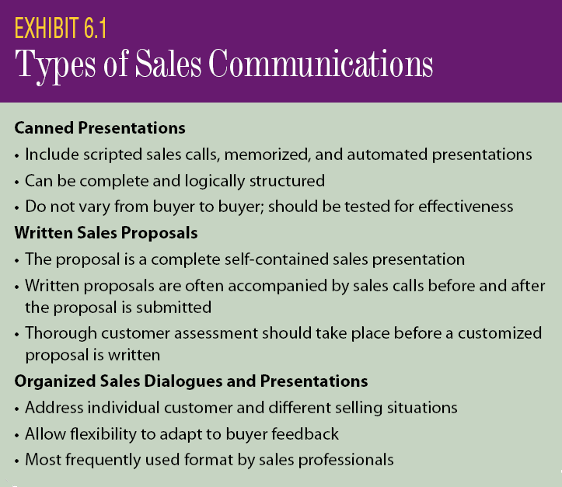
Sales Communications Formats

Slide 7
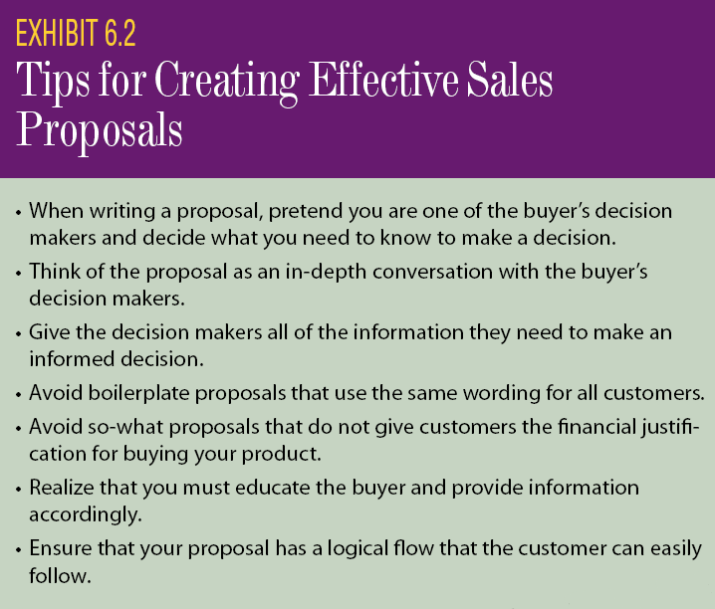
Written Sales Proposal

Slide 8
Components of a Written Proposal
Executive Summary
Customer Needs & Proposed Solutions
Seller Profile
Pricing & Sales Agreement
Suggested Action & Time Table
The quality of a salesperson’s written document is a surrogate for that salesperson’s competence and ability.

Slide 9
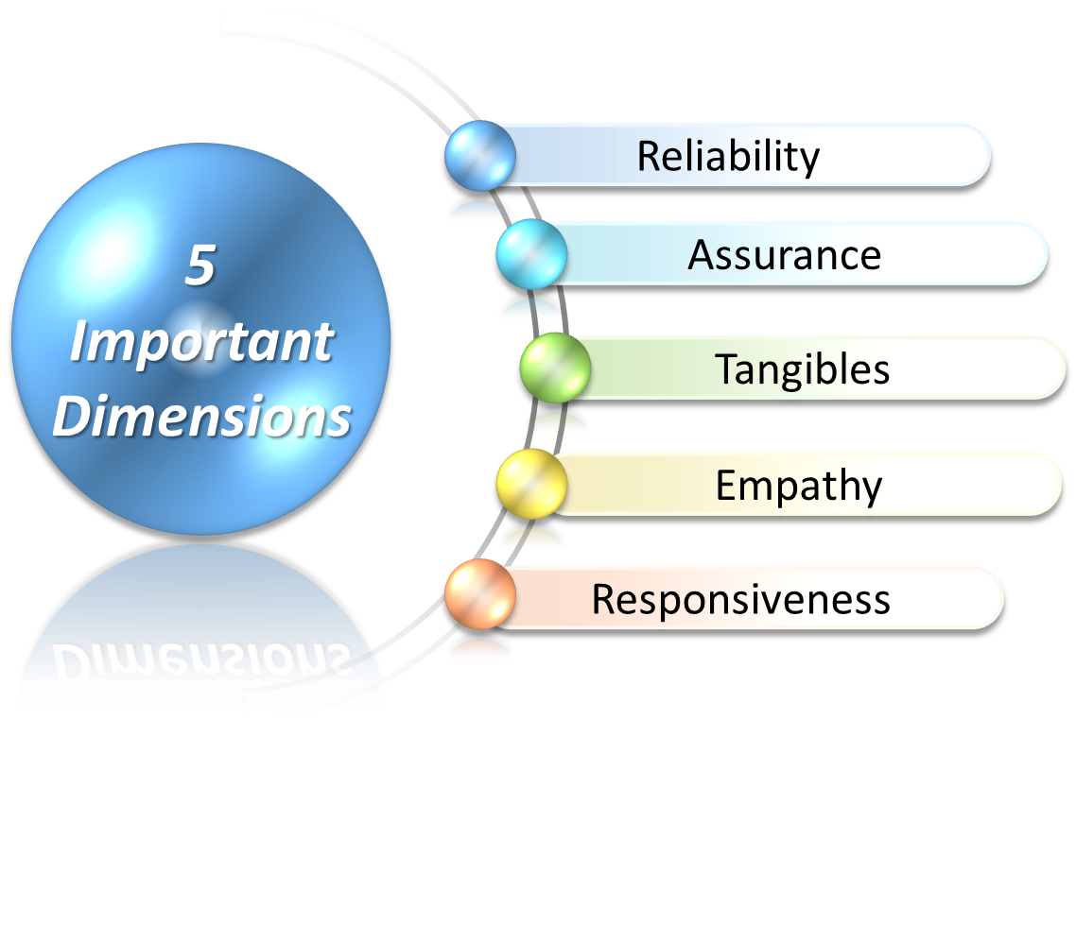
Evaluating Sales Proposal (Five Important Dimensions)

Slide 10

Evaluating Sales Proposal Reliability and Assurance
reflects your (the seller’s) ability to identify creative, dependable, and realistic solutions and strategies and match them to the buyer’s needs and wants.
builds the buyer’s trust and confidence in your ability to deliver, implement, produce, and/or provide benefits.
Reliability

Slide 11


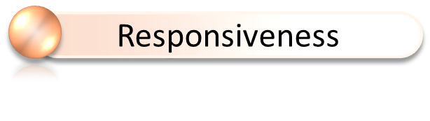
Evaluating Sales Proposal Tangibles, Empathy, & Responsiveness
enhance and support the communication of your message and invite readership by its overall appearance, content, and organization.
confirms your thorough understanding of the buyer’s business and his or her specific needs and wants.
developed in a timely manner and demonstrates a willingness to provide solutions for the buyer’s needs and wants and to help measure results.

Slide 12
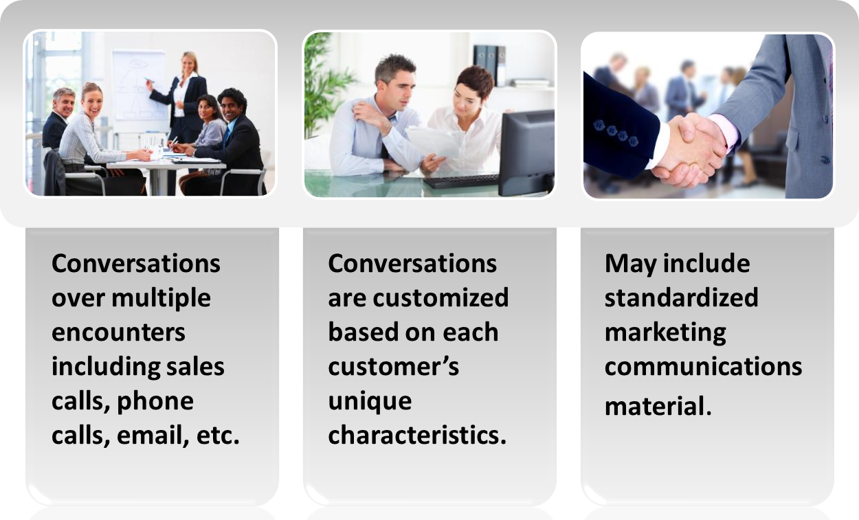
Organized Sales Dialogues

Slide 13
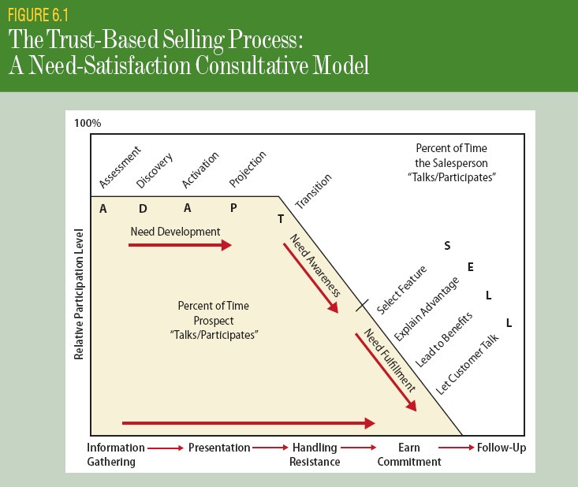
Discovering Needs – Review ADAPT

Slide 14
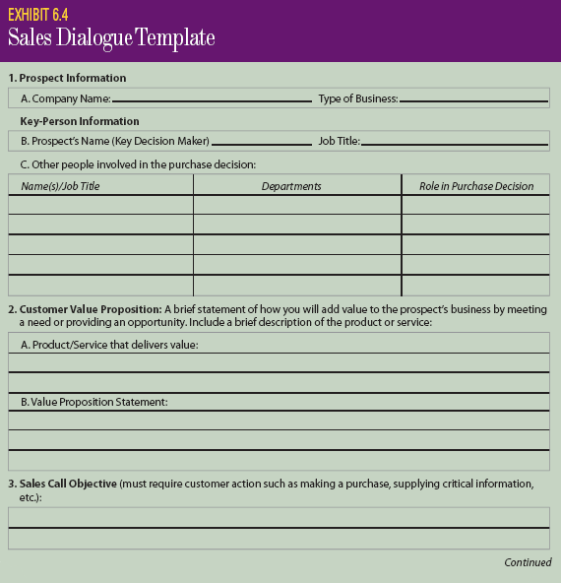
Sales Dialogue Template

Slide 15
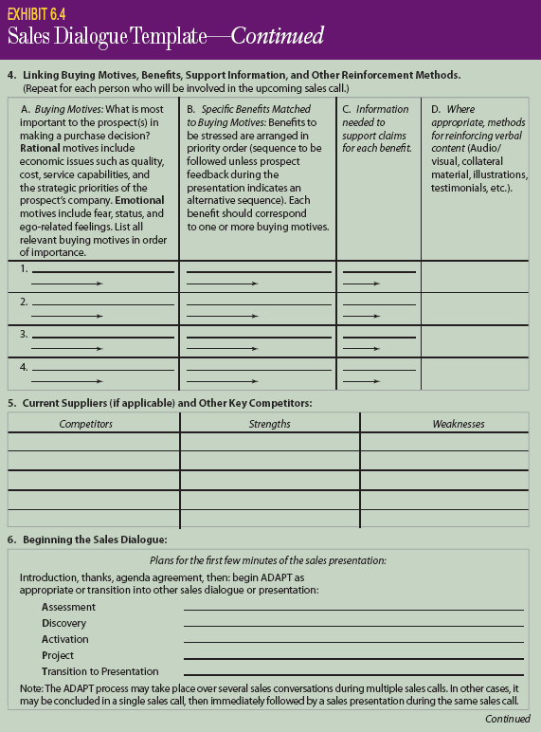
Sales Dialogue Template (cont.)

Slide 16
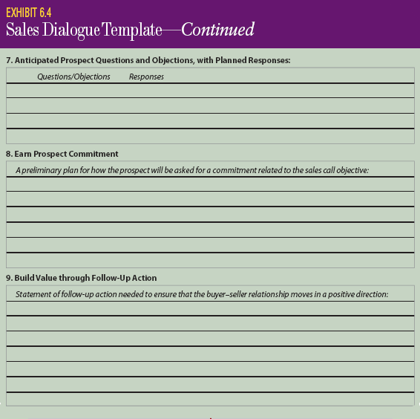
Sales Dialogue Template (cont.)

Slide 17

Customer Value Proposition
Customer Value Proposition: A statement of how the sales offering will add value to the prospect’s business by meeting a need or providing an opportunity.

Slide 18
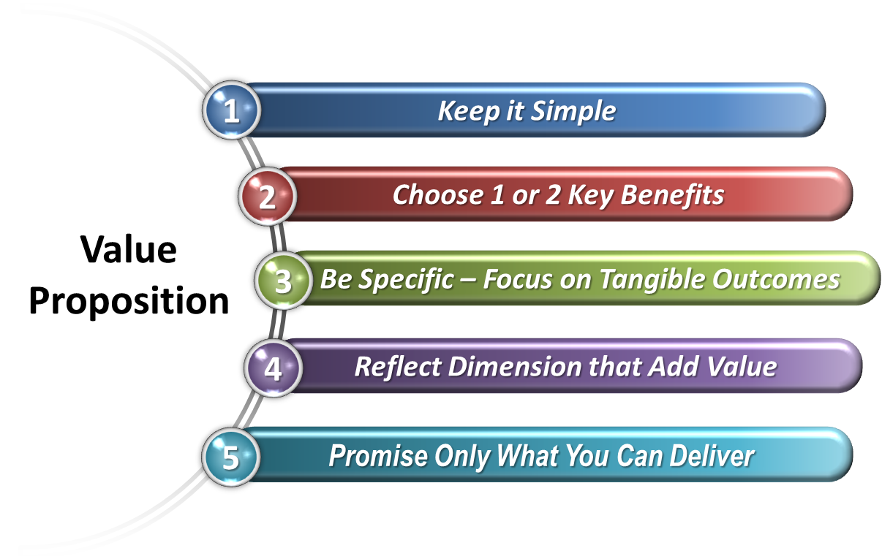
Creating a Value Proposition

Slide 19
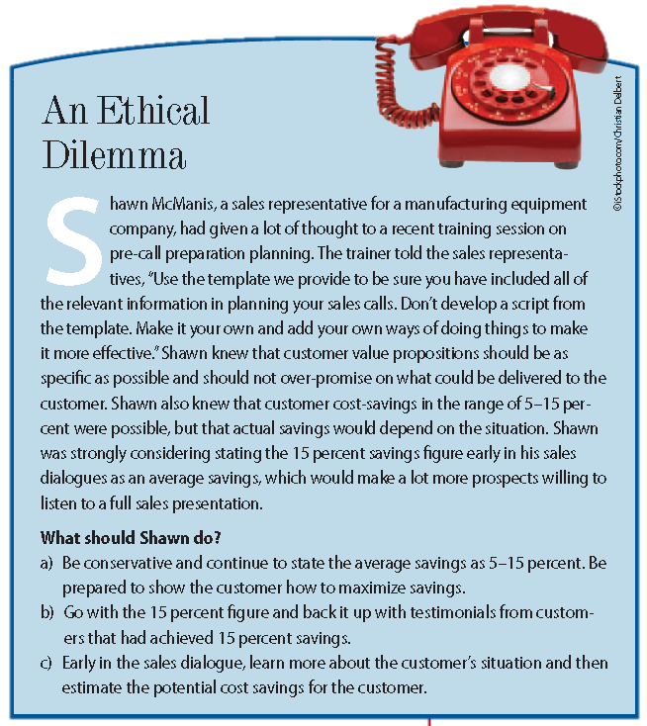
Ethical Dilemma

Slide 20

Buying Motives
Rational Typically relate to the economics of the situation, including cost, profitability, quality, services offered, and the total value of the seller’s offering as perceived by the customer.
Emotional Includes motives such as security, status, and need to be liked; sometimes difficult for salespeople to uncover these motives.

Slide 21
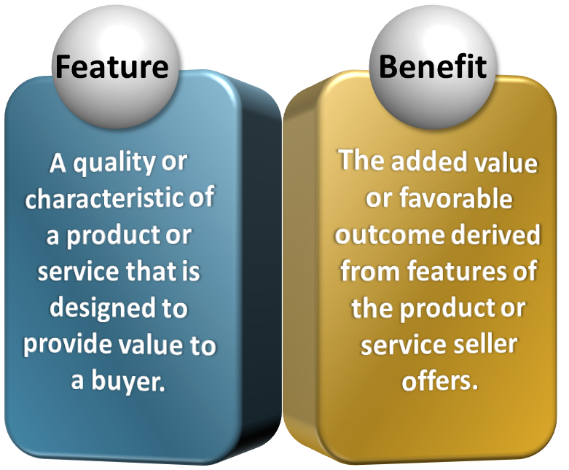
Features and Benefits

Slide 22
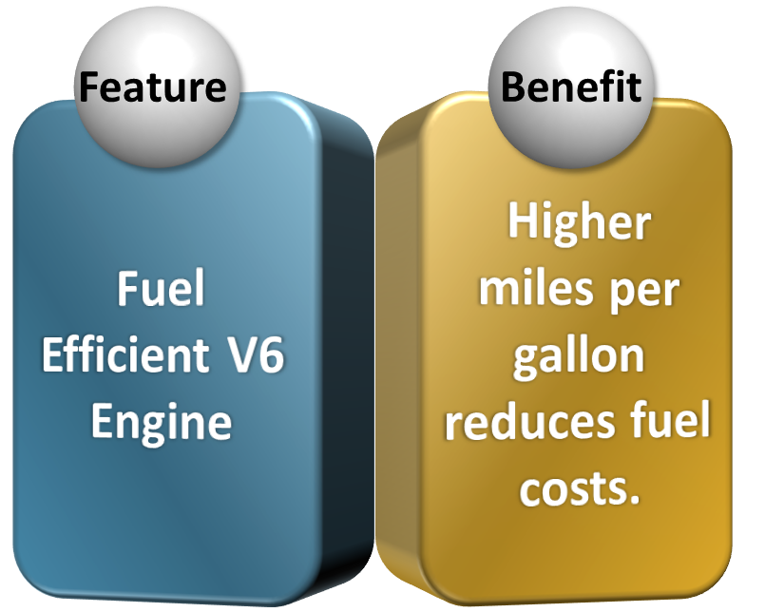
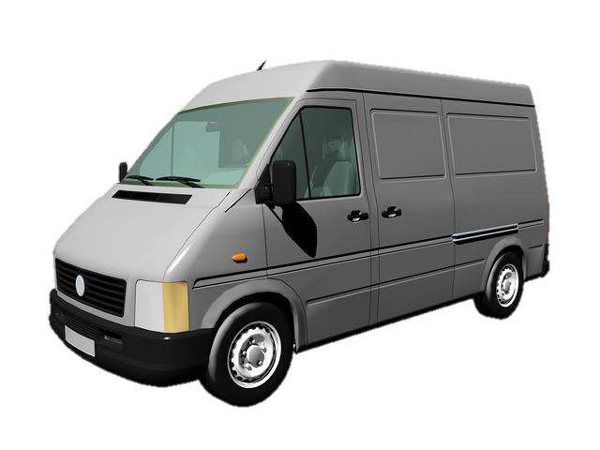
Features and Benefits

Slide 23

Engaging the Customer
Request an appointment
Give the prospect a reason why an appointment should be granted
Request a specific amount of time
Suggest a specific time for the appointment

Slide 24
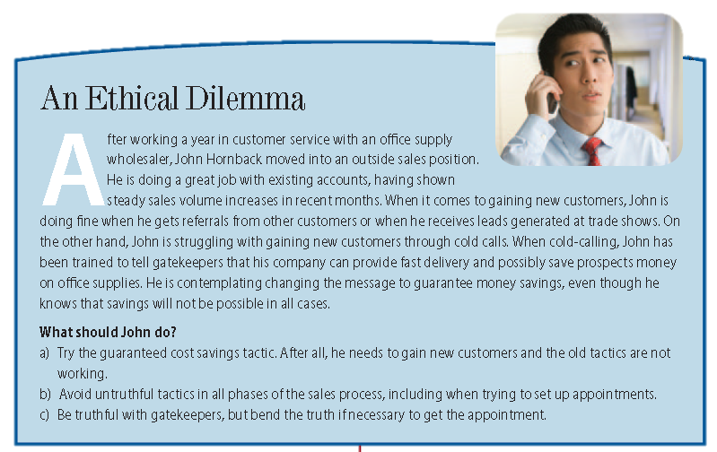
Ethical Dilemma

